Slide 1
Receipt Bank User Input Guide
for FESC MSA Administrators

Slide 2
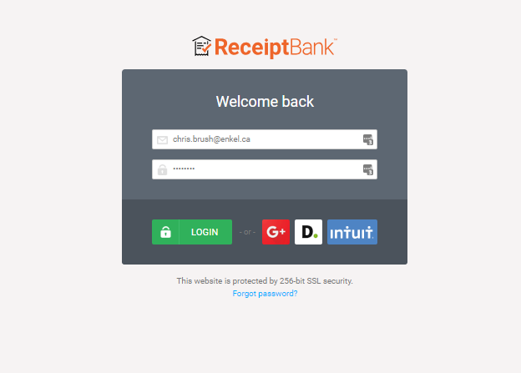
About Receipt Bank
Receipt Bank is a helpful tool to manage receipts and invoices for an organization.
Supporting documentation can be uploaded directly to Receipt Bank
FESC MSA administrators will submit all internal operating expenses to Receipt Bank so that the expenses can be recorded appropriately.

Slide 3
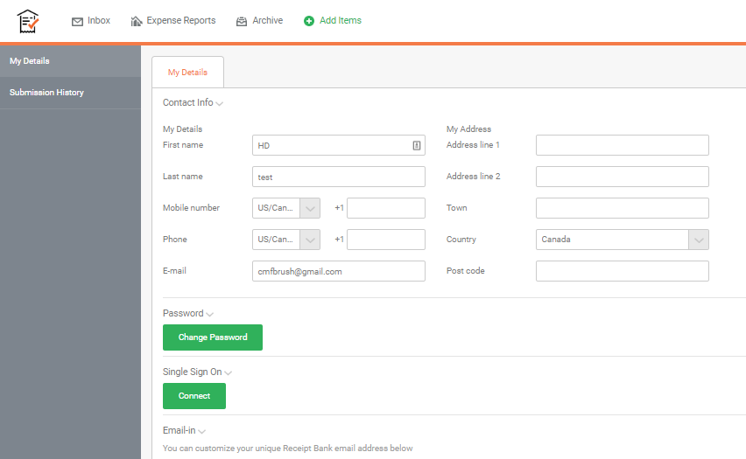
User Sign In
Use the email address and password that were emailed to you upon being added to Receipt Bank and log in.
You can change your password by selecting My Details within the Account Settings menu.

Slide 4
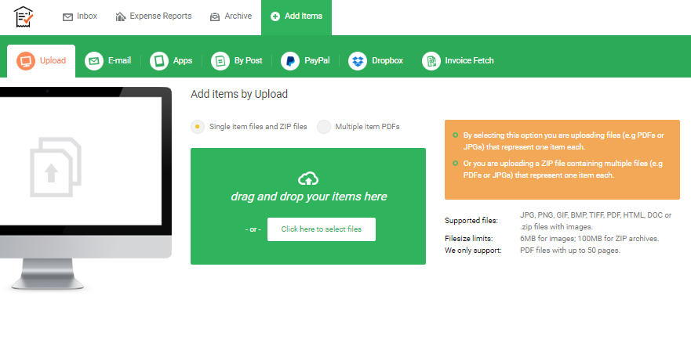
Receipt and Invoice Capture
Receipts and invoices can be added either via the Email-In address noted in the previous slide or as a direct addition using the Add Items drop down menu in the Receipt Bank dashboard.
Receipt Bank will scan all receipts and invoices submitted using either method to determine total amount paid, vendor, date and a number of other relevant data fields.

Slide 5
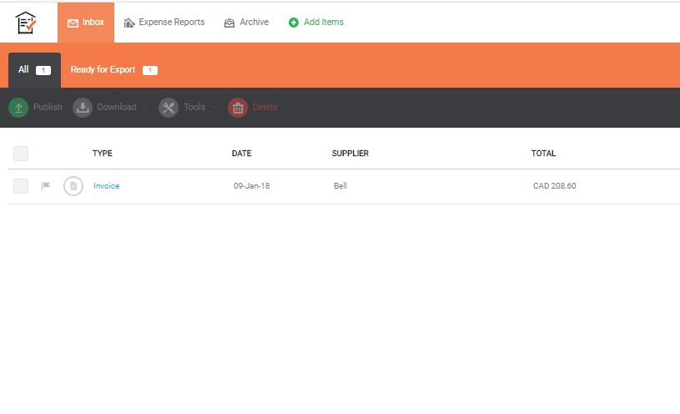
Receipt And Invoice Review
Once receipts and invoices are submitted to Receipt Bank, they will populate in the Inbox.
Receipt Bank uses OCR scanning technology to extract information from receipts and invoices and for use by accounting software systems.
The OCR scanning takes approximately 4 hours to read a receipt or invoice after which the financial information will show up in Receipt Bank also within the Inbox section. We recommend that you upload the receipts and invoices in the evening and come back next morning to make changes.

Slide 6
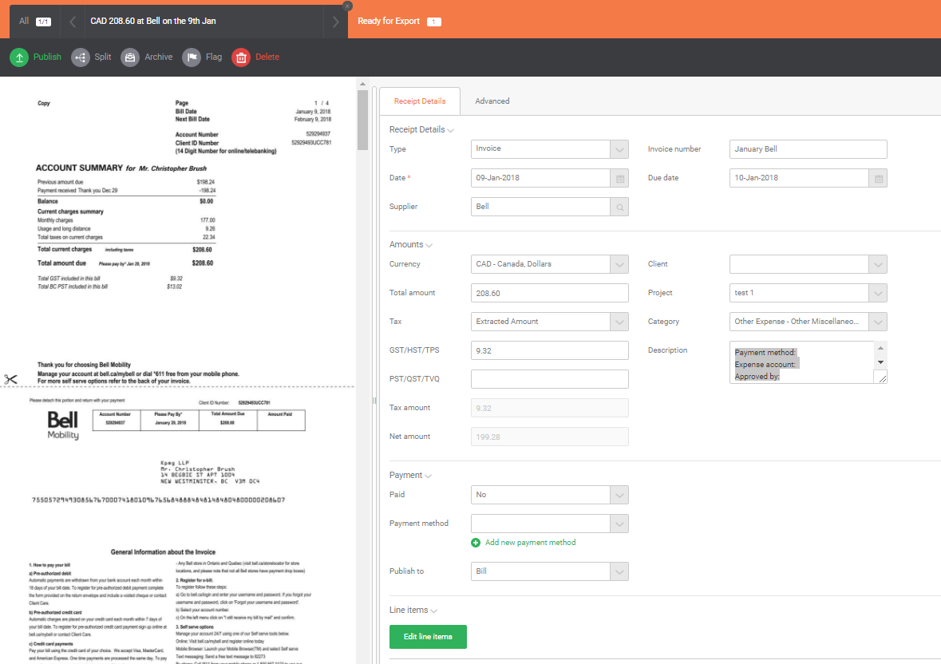
Add Description to Receipts and Invoices
Click into the receipt or invoice to open the financial information that has been captured by the OCR scan.
Complete the Description field with the following information:
1. Payment method
(Note: Payment methods are:
manual cheque, direct credit, MSA credit card)
2. Expense account
3. Approved by
Enkel will ensure all other fields are completed appropriately.
NOTE: changes are automatically saved

